Slide 1
Presentation Setup Don’t Forget
* Jboss 7 running locally!!!
* Very large Firefox console for running underscore examples.
* Small, medium, complex examples ready?
* Printed notes/script out?
* Business cards?
* Empty hands/pockets.

Slide 2
Jump Into Backbone
A tutorial and quick start.

Slide 3
Hi, I’m George Frick
Programming since 1994.
Worked for MPS making websites in 1999.
Graduated from UWM, 2006.
Bachelor of Science, Computer Science
Economics
Linguistics
Software developer for seven years.
Aurora Health Care
iStream Financial
NVISIA LLC

Slide 4
Before We Can Start
Who is the target audience?
Why are we here?
What are we going to learn?
Where are these ideas applicable?
When can I start using it?

Slide 5
Before We Can Start
Who is the target audience?
Any developer looking to make front end applications.
Why are we here?
To learn one of many ways to structure an application while increasing productivity.
What are we going to learn?
How to quickly get started with Backbone.
Where are these ideas applicable?
Primarily SPAs, or Portlet-like applications.
When can I start using it?
Now (I promise).

Slide 6
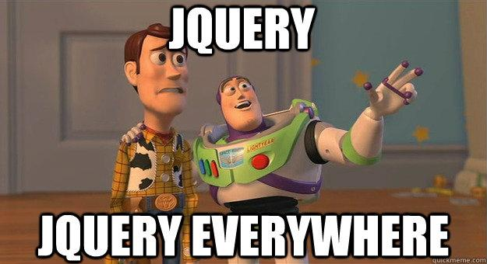
In The Beginning

Slide 7
The Grass Is Greener...
Let’s Modularize!
Haven’t we been here before?
Let’s Test!
Haven’t we been here before?
Let’s Separate Code From HTML
Haven’t we been here before?
… We JUST worked through all of this on the server.
… So with that in mind, let’s jump in!

Slide 8
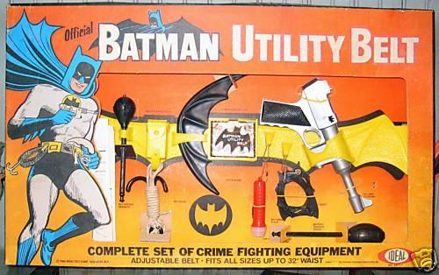
_Underscore

Slide 9
_Underscore
Utility belt
80 functions
“It’s the tie to go with JQuery’s tux.”
Let’s jump into some examples!

Slide 10
Underscore By Example.
each
pluck
union
bind/bindAll
pick/omit
http://underscorejs.org/#extend (big one)
Quickly! To the IDE!

Slide 11

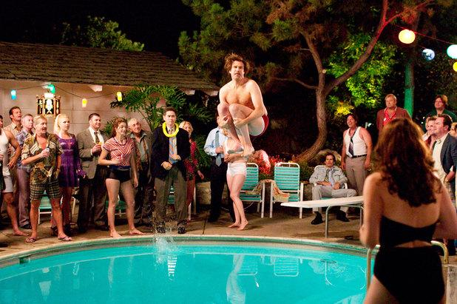
A simple MVC/MV* framework.
Declarative Interface
Restful Support

Slide 12
The Shallow End
Some Structural Tips
Simple Model
Simple Collection
Simple View
Handle Simple Events
Baxter, is that you? Baxter! Bark twice if you’re in Milwaukee the IDE!

Slide 13
Examples That Fall Short
A very simple example.
Learned some things.
As soon as you try to use it - Frustration.

Slide 14
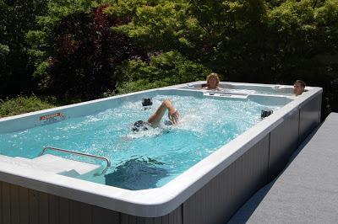

Slide 15
The Lap Pool
More Structural Tips
Multiple Models
Multiple Collections
Check Boxes, Select Boxes
More Events
<span class=”butcheredQuote”>We’re Going To See Code.</span>

Slide 16
Examples That Help You Decide
Some everyday problems.
Beginning to see usage patterns.
As soon as you try it - Surprise Complexity.

Slide 17
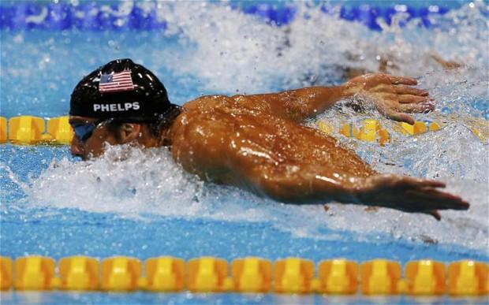

Slide 18
We Want Gold
Tools for Structure.
Tools for Building.
Work Patterns.
Complex Router/Models/Views.
Complex Eventing.
Swimming Coding is normal for me. I’m relaxed. I’m comfortable, and I know my surroundings. It’s my home.

Slide 19
Summary
In the beginning, chaos reigned.
Put on your utility belt.
Add MV* to give your app a Backbone.
High productivity
Readable
Teachable
Maintainable
Add templating.
“Automate all the things.”

Slide 20
Thanks & Resources
Thanks for attending!
http://jquery.com/
http://underscorejs.org
http://backbonejs.org/
http://handlebarsjs.com/
http://georgefrick.github.io/BackboneApplicationExample/
All three apps are on Github!
https://github.com/georgefrick
George Frick
george.frick@gmail.com
@beercitycoder

